Slide 1
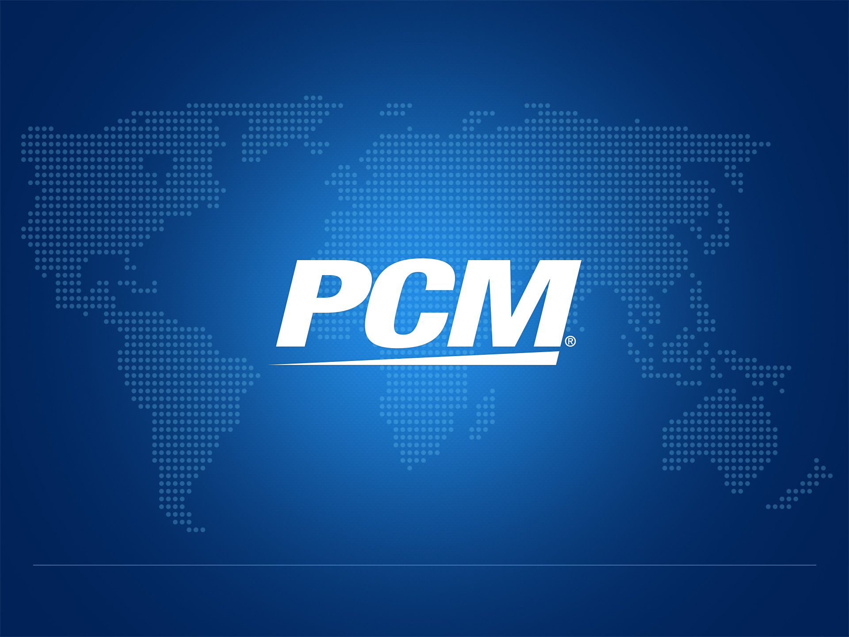
• Brandon H. LaVerne, Chief Financial Officer
• January 2013

Slide 2
Forward Looking Statements
This presentation may contain forward-looking statements within the meaning of Section 27A of the Securities Act of 1933, as amended, and Section 21E of the Securities Exchange Act of 1934, as amended. Such forward-looking statements include statements regarding our expectations, hopes or intentions regarding the future; including, but not limited to expectations or statements relating to our financial goals for 2012 or beyond, statements related to expanded business models and opportunities and benefits of our investments in these business models and markets, statements related to strategic developments such as statements related to our brand strategy and related potential benefits of a more streamlined and unified brand strategy, statements related to our new headquarters and the related benefits to our customers, vendors and employees and impact on future growth, statements related to overhead cost savings and related impact on future periods, statements related to the benefits of the coupon business or other statements or expectations or goals for sales growth or operating leverage. Forward-looking statements involve certain risks and uncertainties, and actual results may differ materially from those discussed in any such statement. Factors that could cause our actual results to differ materially include without limitation the following: risks or uncertainties related to our ability to retain key employees, expanded business models and related investments; risks relates to our IT infrastructure, uncertainties relating to the relationship between the number of our account executives and productivity; risks related to our ability to receive expected returns on strategic investments such as investments in new offices, decreased sales related to any of our segments, including but not limited to, potential decreases in sales resulting from the loss of or a reduction in purchases from significant customers; availability of key vendor incentives and other vendor assistance, increased competition, including, but not limited to, increased competition from direct sales by some of our largest vendors and increased pricing pressures which affect our pricing strategy in any given period; the effect of the our pricing strategy on our operating results; risks related to our ability to identify suitable acquisition targets, to complete acquisitions of identified targets (including the challenges and costs of closing the transaction), and our ability to integrate companies we may acquire and our ability to achieve synergies expected from such acquisitions; the impact of acquisitions on relationships with key customers and vendors; potential decreases in sales related to changes in our vendors products; risks of decreased sales related to the potential lack of availability of government funding applicable to our PCM-G contracts; the impact of seasonality on our sales; availability of products from third party suppliers at reasonable prices; risks of business and other conditions in the Asia Pacific region and our limited experience operating in the Philippines, which could prevent us from realizing expected benefits from our Philippines operations; increased expenses, including, but not limited to, interest expense, foreign currency transaction gains/losses, and other expenses which may increase as a result of future inflationary pressures; our advertising, marketing and promotional efforts may be costly and may not achieve desired results; risks due to shifts in market demand or price erosion of owned inventory; risks related to our expanded coupon business, including regulatory and litigation risks, market acceptance of the expanded business model, competition and emerging market risks; risks related to foreign currency fluctuations; risks related to warranties and indemnities we may be required to provide to third parties through our commercial contracts; risks related to data security; litigation by or against us; and availability of financing, including availability under our existing credit lines. Additional factors that could cause our actual results to differ are discussed under the heading “Risk Factors” our Form 10-Q for the quarter ended September 30, 2012, on file with the Securities and Exchange Commission, and in our other reports filed from time to time with the SEC. All forward-looking statements in this document are made as of the date hereof, based on information available to us as of the date hereof, and we assume no obligation to update any forward-looking statements.
2

Slide 3
Non-GAAP Reconciliation
We are presenting earnings before interest, taxes, depreciation and amortization expenses (EBITDA), which is a financial measure that is not determined in accordance with accounting principles generally accepted in the United States of America, or GAAP. EBITDA should be used in conjunction with other GAAP financial measures and is not presented as an alternative measure of operating results, as determined in accordance with GAAP. We believe that this non-GAAP financial measure allows a more meaningful comparison of our operating performance trends to both management and investors that is more indicative of our consolidated operating results across reporting periods. Depreciation and amortization expenses primarily represent an allocation to current expense of the cost of historical capital expenditures and for acquired intangible assets resulting from prior business acquisitions. A reconciliation of the non-GAAP consolidated financial measure is included in a table below.
 | 2009 | 2010 | 2011 | 2012*
Reported Operating Profit | $7,742 | $14,468 | $9,456
Depreciation/Amortization | 5,597 | 8,157 | 10,044
EBITDA | $13,339 | $22,625 | $19,500 | >$26,600
* 2012 figures are based on financial goals disclosed by the Company and exclude restructuring and related charges.
3

Slide 4
Who is PCM?
We are a leading technology solutions provider to businesses, government and educational institutions and individual consumers. We help clients make the right technology choices and provide cost effective product acquisition, solution implementation and project management to ensure that their investment is maximized.
4

Slide 5
Fast Facts
Founded | 1987
Headquarters | El Segundo, CA (near LAX)
Employees | Over 2,900 worldwide
Symbol – Exchange | PCMI (NASDAQ)
Shares Outstanding¹ | 12.0 million
Average Trading Volume² | 23,100
Insider Ownership³ | 26%
TTM Revenues¹ | $1.46 billion
2011 EBITDA⁴ | $19.5 million
2012 EBITDA Goal⁴ | $26.6 million
Annual Services Run Rate¹ | $120 million +
Market Capitalization² | $78 million
1 – Through/as of Q3 2012
2 – Most recent proxy (as of April 30, 2012)
3 – Yahoo Finance, 1/2/2013
4 – Non-GAAP number. See reconciliation of non-GAAP information at the beginning of this presentation. 2012 figure excludes severance and restructuring related expenses.
5

Slide 6
Recent Announcements
Q3 Earnings Announcement – November 8
Sales down 1% to $365 million; grew 1% excluding vendor program change
Delivered Services grew 11% and now 8% of sales
Gross margin 13.3% vs. 13.7% last year and 13.4% in Q2. PY included one-time margin benefit from significant HP TouchPad sales on HP’s exit from the category
SG&A margin 12.2% vs. 12.6% last year
EBITDA grew 10% to $7.1 million (including $0.7 million restructuring related expenses)
Discussed financial goals for Q4
Revenue and EBITDA up sequentially from Q3
Announced hiring of Oren J. Hartman, EVP of Corporate Sales on December 3
6

Slide 7
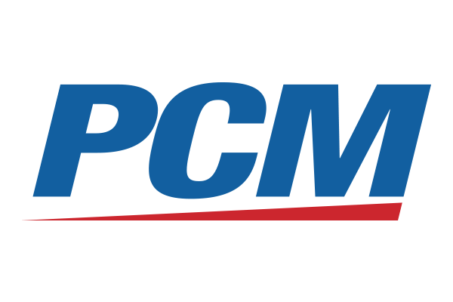
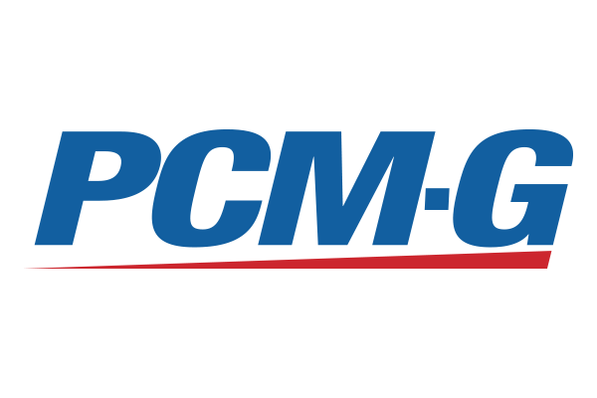
Strategic Developments
Rebranding and Restructuring Initiated January 1
Name change from PC Mall
Merger of commercial subsidiaries and brands
PC Mall, Sarcom, NSPI & PC Mall Services
now simply PCM
PC Mall Gov now PCM-G
Consolidation of services capabilities
Cost Savings Initiatives continuing
YTD Actions - $7.3 million annualized (over half in Q3)
Expected Q4 actions of over $1.3 million
Continuing to emphasize solutions and services sales to grow margin while optimizing back-office operations to reduce SG&A as a percentage of sales
7

Slide 8
Our Customers
We proudly serve customers in the Fortune 500, leading small and mid-sized businesses, multiple government agencies nation wide and individual consumers.
8

Slide 9
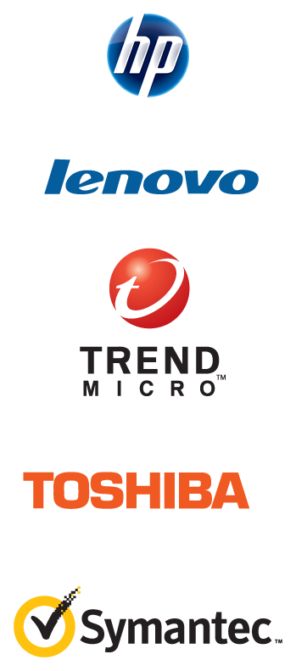
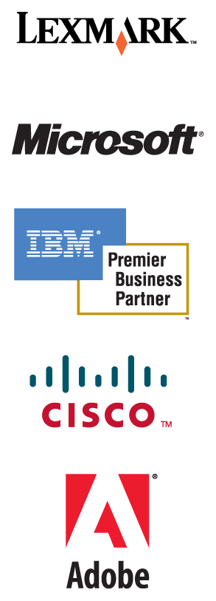
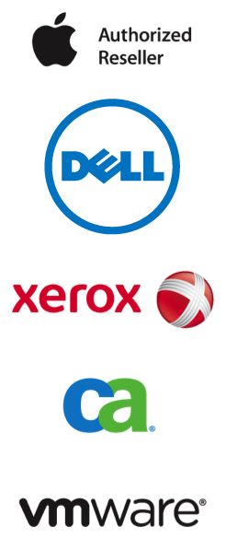
Our Partners
Our partners are the most respected technology manufacturers and publishers in the industry. We hold enterprise-level certifications in order to maximize value to our customers.
9

Slide 10
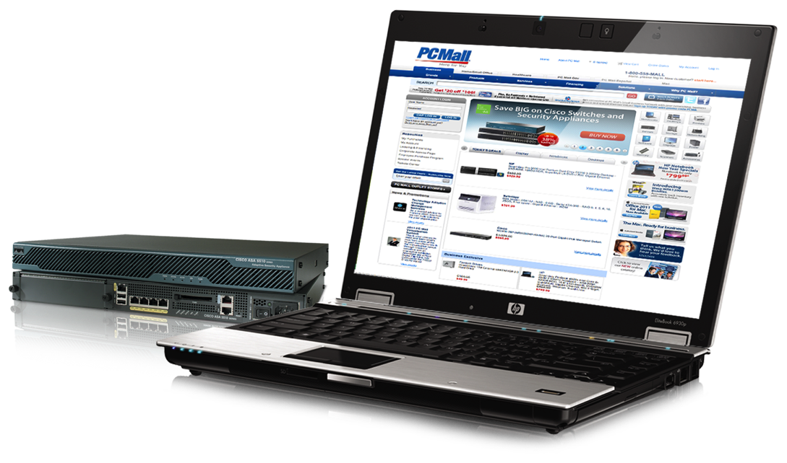
Go-to-Market Strategy
Our unique strategy combines the benefits of value-added service and solution offerings with the efficient capabilities and high volume sales of a leading direct market reseller to create a total technology solution for our customers.
10

Slide 11
Service Offerings
Consulting Services (CSO)
Professional Services (PSO)
Lifecycle Services (LSO)
Managed Services (MSO)
Acquisition Services
Assessments
Analysis
Design
Business Solutions
Planning
Strategy
Change Management (Abreon)
Configuration
Installation
Remediation
Upgrades
Migrations
Troubleshooting
Help Desk
Desk Side Support
Field Installation
Cabling
Imaging & Deployment
Training
Cloud Services
Data Center Hosting & Management
Remote Monitoring & Management
Business Continuity
Custom Catalog
Real Time Pricing
Real Time Availability
B2B and ERP Integration
Contract Management
11

Slide 12
Complete IT Lifecycle
Value Added Services – Total IT Lifecycle Management
Monitoring
& Operations
Project
Management
U.S – Based
Help Desk
Integration &
Configuration
Field Service
Warehousing
& Logistics
Systems Refresh
& Installation
eProcurement
Recycling
& Disposal
12

Slide 13
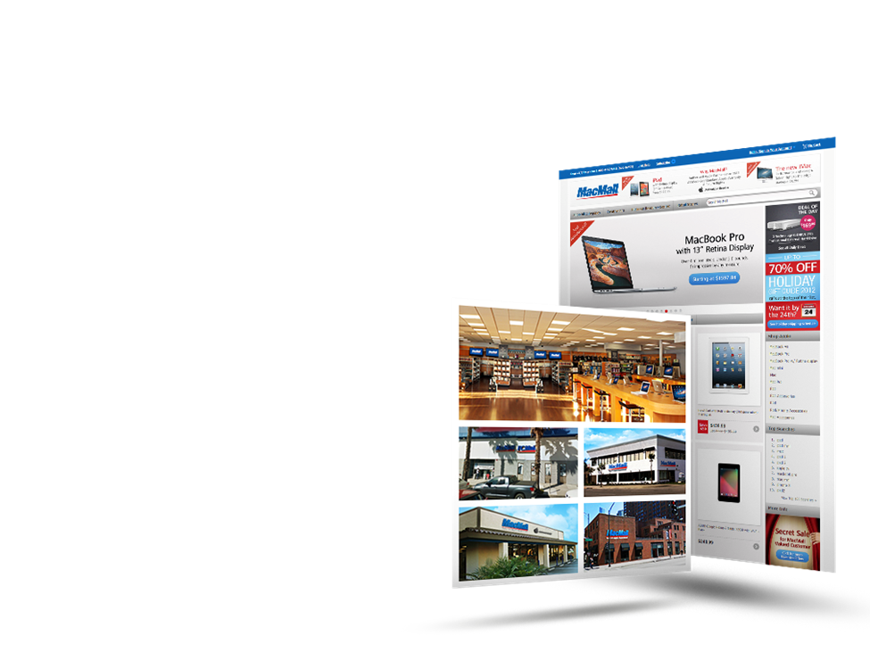
MacMall
MacMall is one of the largest direct marketers of Apple products in the United States.
Strategic focus on small businesses, creative professionals and high-end consumers
Utilizes a high-tough telephone-based sales force, supported by Web-based marketing and Web sites
Operates four retail stores
3 in Southern California
1 in Chicago
13

Slide 14
Reportable Segments - 2012
14

Slide 15
Reportable Segments – Q3 2012
SMB
MME
Public Sector
MacMall/Onsale
Corp/Other
Consolidated
($ in millions)
Revenues | $118.6 | $137.1 | $57.0 | $51.9 | $0.0 | $364.6
Gross Profit | $16.4 | $20.7 | $5.3 | $5.9 | $0.1 | $48.4
Gross Margin | 13.8% | 15.1% | 9.4% | 11.3% |  | 13.3%
Operating Profit | $9.1 | $7.4 | $1.9 | $0.8 | ($15.2) | $4.0
Operating Margin | 7.6% | 5.4% | 3.4% | 1.5% |  | 1.1%
15

Slide 16
Return to Efficient Growth
* EBITDA is a non-GAAP measure. See non-GAAP explanation and reconciliation included herein.
2012 figures based on low end of management goals for Q4 and excludes restructuring and related charges.
16

Slide 17
Balance Sheet and Cash Flow
 | 9/30/12 | 12/31/11
Current Assets | 288,514 | 310,543
Working Capital | 56,151 | 45,277
Revolving LOC | 60,809 | 91,852
Other Debt | 17,528 | 12,589
Days Sales Outstanding (DSO) | 50 | 49
Days Payables Outstanding (DPO) | 34 | 33
Days Inventory Outstanding (DIO) | 19 | 22
Cash Conversion Cycle (CCC) | 35 | 38
Operating Cash Flow (9 mo) | 34,581 | 494
CapEx (9 mo) | 6,765 | 21,861
17

Slide 18
Catalysts to Growth and Profitability
Brand unification/restructuring
Refine customer segmentation and alignment
Consolidation of services offerings
Leveraging of solutions portfolio across customer base
Completion of new sales tools
Continuation of cost savings initiatives
Selective hiring of strategic leadership
Completion of new ERP systems
Continued market share gains from local VARs
Upgrade cycle for Windows 8 in the Enterprise
18

Slide 19
Q&A

