Slide 1
Phase I/IIa Study of Human Embryonic Stem Cell-Derived Retinal Pigment Epithelium Cells Transplanted Subretinally in Subjects with Advanced Dry-Form
Age-Related Macular Degeneration: Interim Results
Eyal Banin, MD, PhD
Center for Retinal and Macular Degenerations (CRMD)
Department of Ophthalmology,
Hadassah-Hebrew University Medical Center, Jerusalem, Israel
On behalf of the participating investigators and clinical trial staff

Slide 2
Co-Authors
Eyal Banin: Patent, Consultant; Adiel Barak: Investigator; David Boyer: Investigator, Consultant; Diana V. Do: Investigator, Consultant; Rita Ehrlich: Investigator; Tareq Jaouni: Investigator; Richard McDonald: Investigator; David G. Telander: Investigator; Maria Gurevich: Cell Cure Neurosciences, Employment; Ohad Cohen: Cell Cure Neurosciences, Employment; Gary S. Hogge: BioTime Inc., Employment; Benjamin Reubinoff: Cell Cure Neurosciences, Patent, Consultant
Study Sponsor
BioTime, Inc.
Cell Cure Neurosciences (a wholly-owned subsidiary of BioTime)
2

Slide 3
Participating principal investigators and sites
Adiel Barak, Sourasky Medical Center, Tel Aviv, Israel
David Boyer, Retina Vitreous Associates Medical Group Los Angeles, CA, USA
Diana V. Do, Byers Eye Institute, Stanford, Palo Alto, CA, USA
Rita Ehrlich, Rabin Medical Center, Petah Tikva, Israel
Tareq Jaouni, Hadassah-Hebrew University Medical Center, Jerusalem, Israel
Richard McDonald, West Cost Retina Group, San Francisco, CA, USA
David Telander, Retinal Consultants Medical Group, Sacramento, CA, USA
We wish to thank all subjects who are participating in this study
3

Slide 4
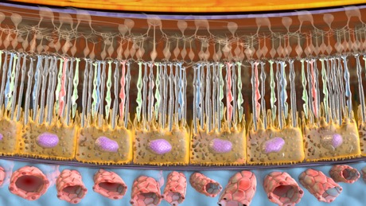
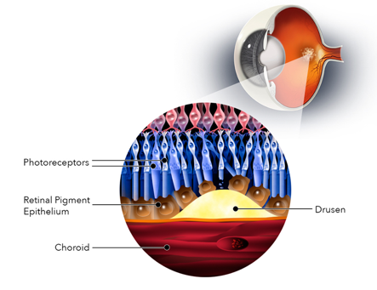
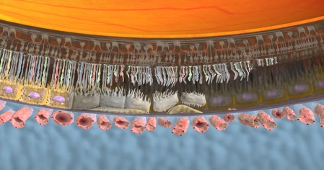
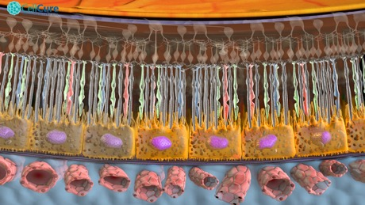
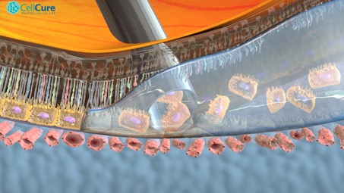
Cell-based therapy to replace/support dysfunctional and degenerated RPE in dry AMD with GA
Dry-AMD: Drusen
Normal Outer Retina
RPE dysfunction and loss,
secondary photoreceptor injury
Transplantation of RPE cell suspension
Desired outcome
Transplanted RPE integration and function, Photoreceptor survival

Slide 5
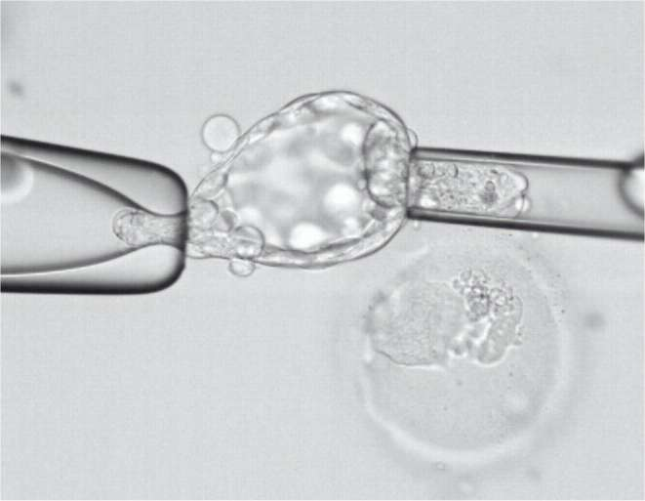

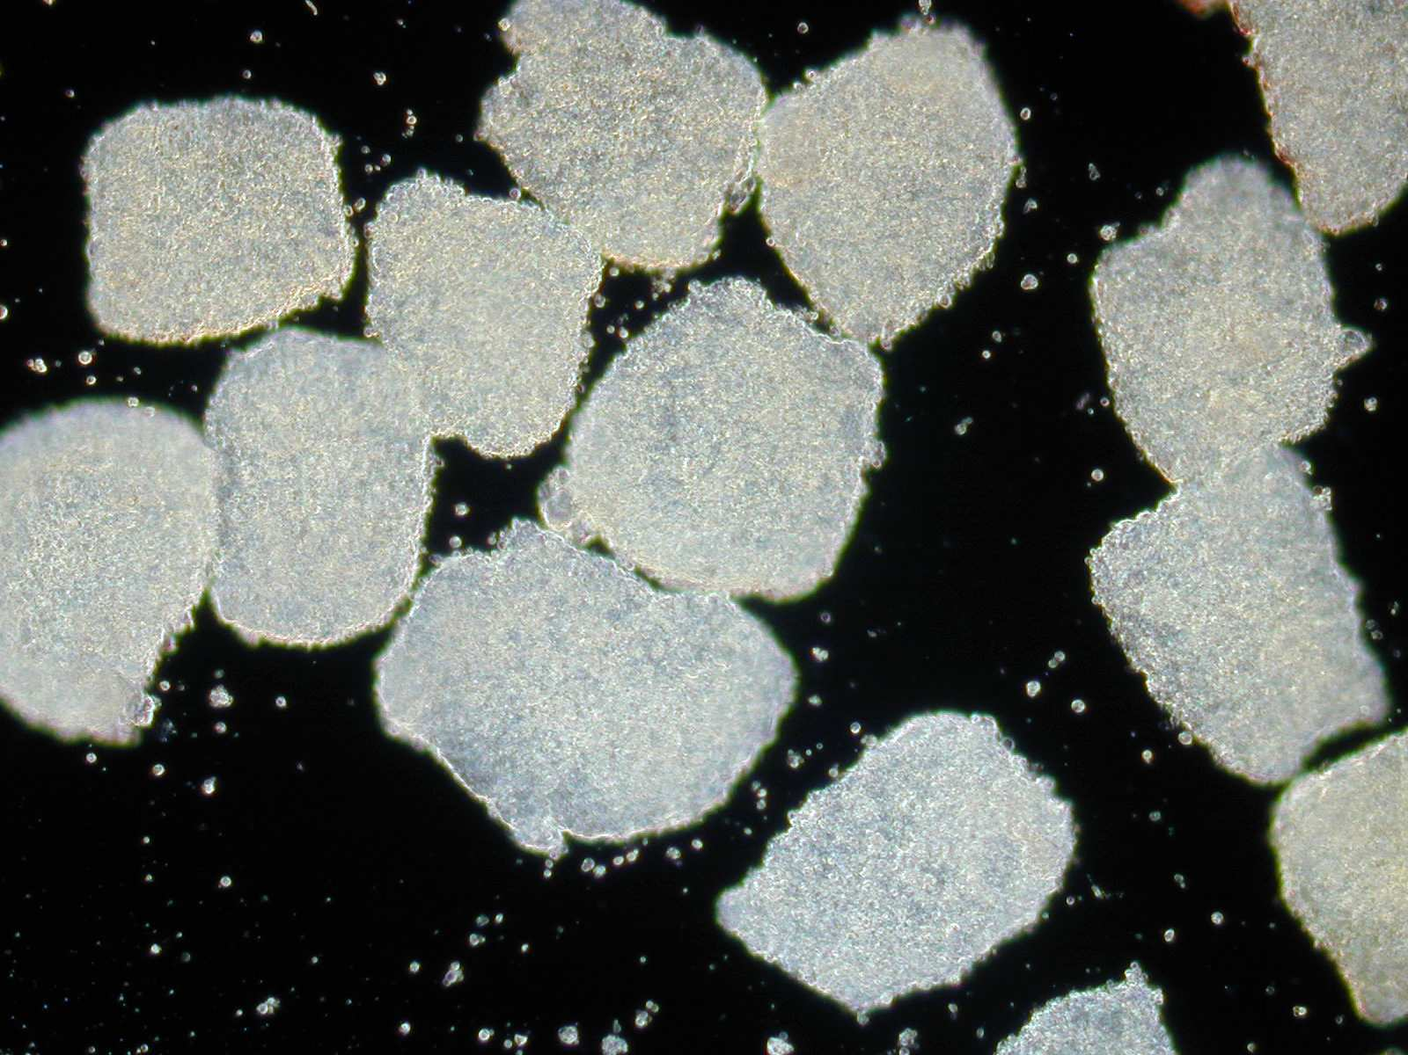
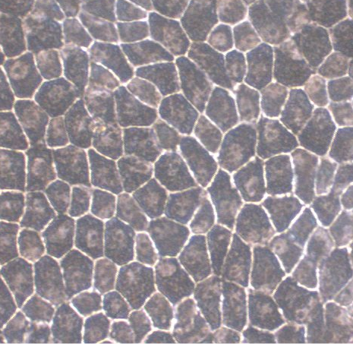
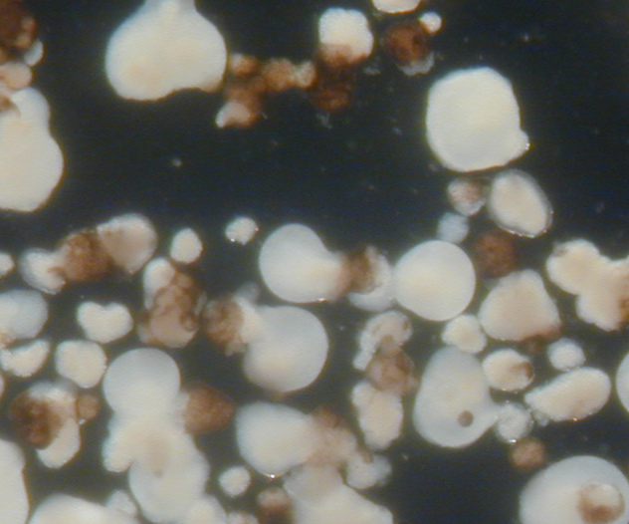
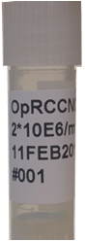
Human Embryonic Stem Cells (hESC) Derived Retinal Pigmented Epithelial (RPE) Cells – OpRegen®
Directed differentiation of hESC to RPE under GMP conditions
RPE cells
Clinical grade Embryonic
stem cell clusters
Neural Spheres w/ pigmented areas
M. Idelson et al., Cell Stem Cell 2009

Slide 6
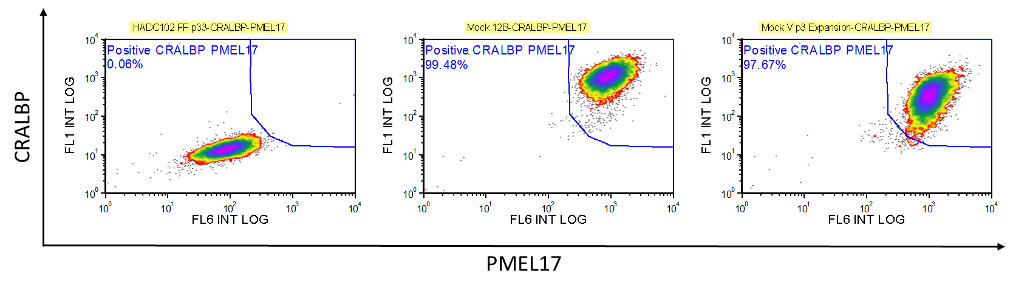
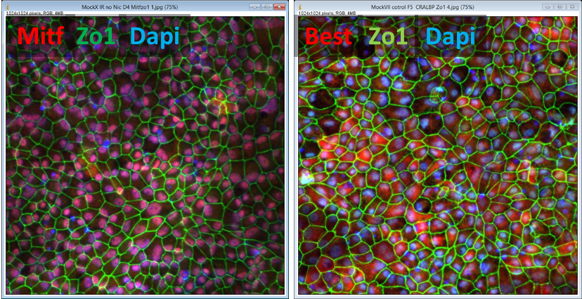
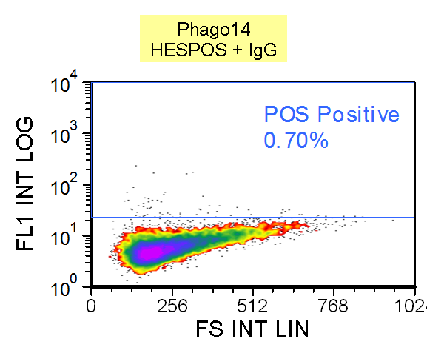
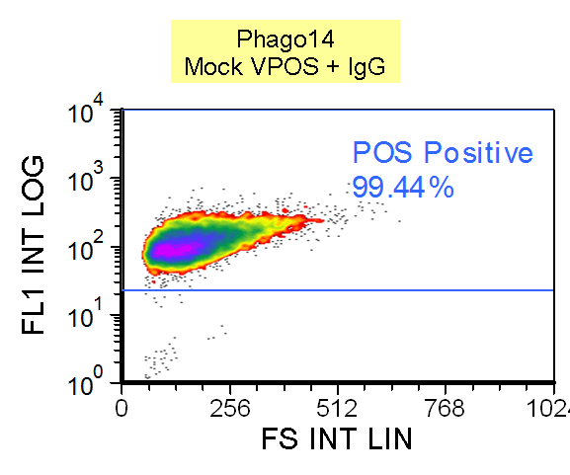
In Vitro Pre Clinical Data: Identity and Functionality
In-Vitro Immuno-fluorescence
hESCs
OpRegen
Identity And Purity Assay
CRLBP ZO1 DAPI
0.06% CRLBP PMEL17
Positive
99.5% CRLBP PMEL17 Positive
CRLBP
PMEL 17
Functionality: Phagocytosis Assay
99.4% POS Positive
MiTF ZO1 DAPI
0.7% POS Positive
Photoreceptor
outer segment fluorescence
Forward Scatter

Slide 7
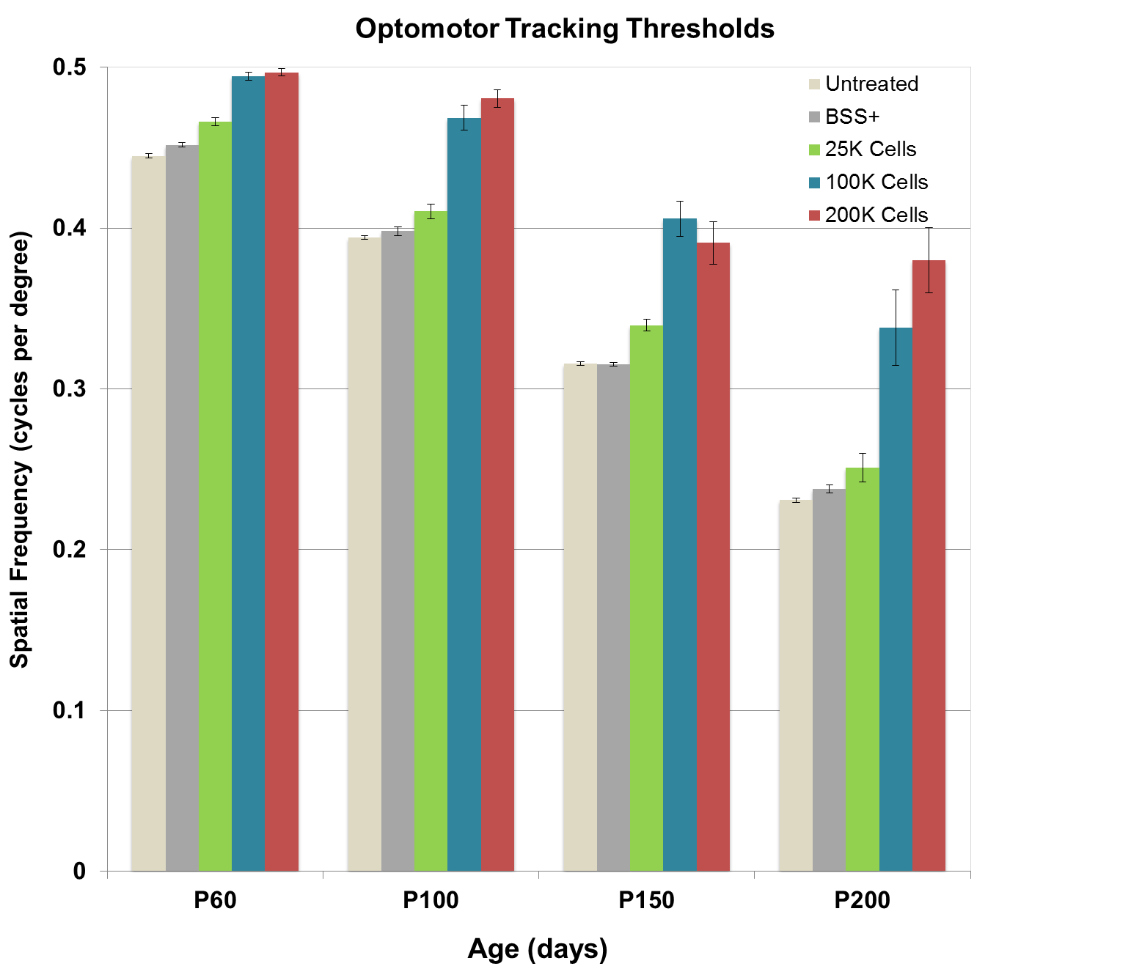
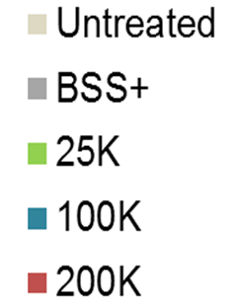
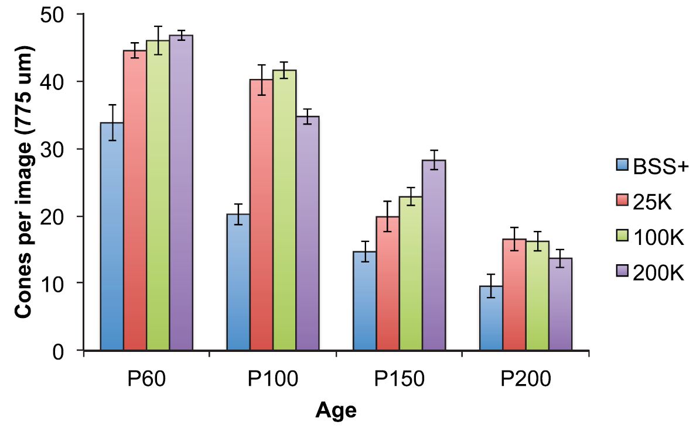
In-Vivo Pre Clinical Data: Efficacy
Optomotor Tracking Threshold In RCS Rats
Cone quantification in RCS Rats
Spatial frequency (cycles per degree)
TJ McGill, et al. Transl Vis Sci Technol. 2017;6(3):17

Slide 8
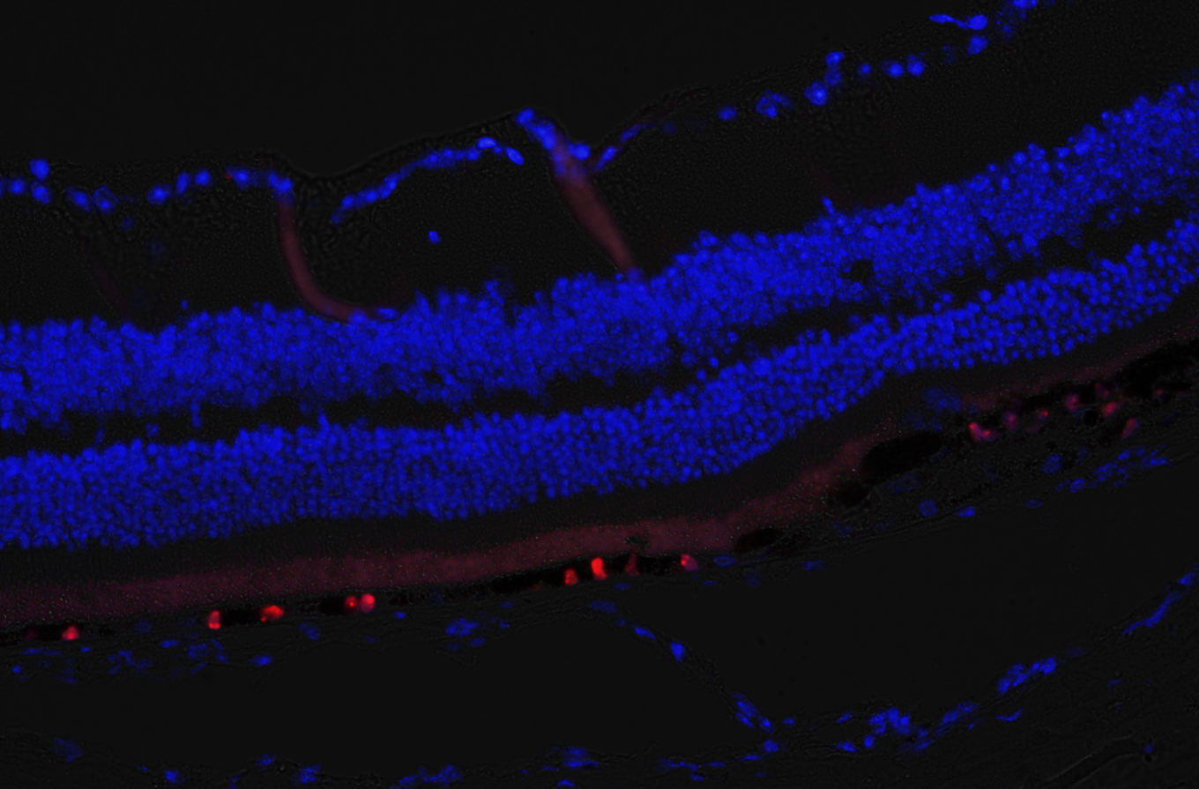
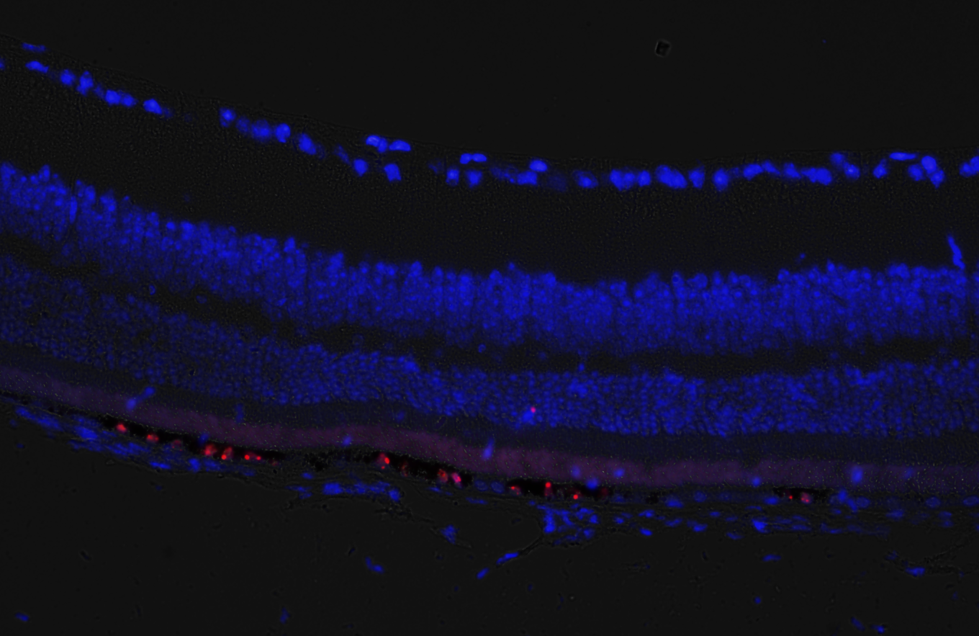
Engraftment and survival of hESC-RPE in three animal species
RCS rat
19 weeks post transplantation
NOD-SCID mouse
Pig retina
3 months post transplantation
anti-GFP
anti- human Nuclei
Human specific marker Tra-1-85
Nuclei were counter-stained with DAPI

Slide 9
Study design, population, management
Parameter | Cohort 1-3 N=12 | Cohort 4 N=12
Phase/design | Phase I-IIa; staggered design; IND (NCT02286089)
Duration | Screening up to 8 Weeks; FU – 1 year; long term FU – 4 years
Management | Central reading/central labs/ Independent DSMB/Advisory Committees
Treated disease | Advanced Dry AMD and GA
Dose | Cohort 1: 50K cells Cohort 2-3: up to 200K cells | Up to 200K cells
GA size – Central Reading assessment | ≥ 1.25mm² ≤ 17 mm² | ≥ 4 mm² and ≤ 11 mm²
BCVA | ≤ 20/200 | ≥ 20/64 and ≤ 20/250
Historical Growth of GA | NA | SQRT per year of > 0.25 mm
Cataract status | Not defined | Pseudophakic
Significant concomitant diseases exclusion (systemic/ocular) | Defined

Slide 10
Study assessments
Endpoints | Assessments
Primary: Safety | Adverse Events
Secondary: Anatomical and Functional Ocular findings | Clinical / Imaging Outcomes BCVA OCT FAF Fundus Photography FQ25 QOL* Reading Speed Test* Microperimetry* * Ongoing in Cohort 4 subjects

Slide 11
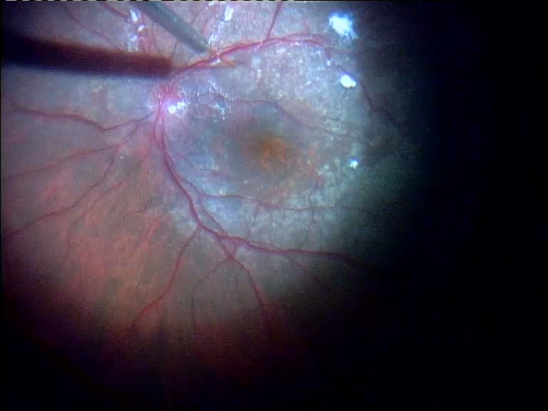
OpRegen® Transplantation

Slide 12
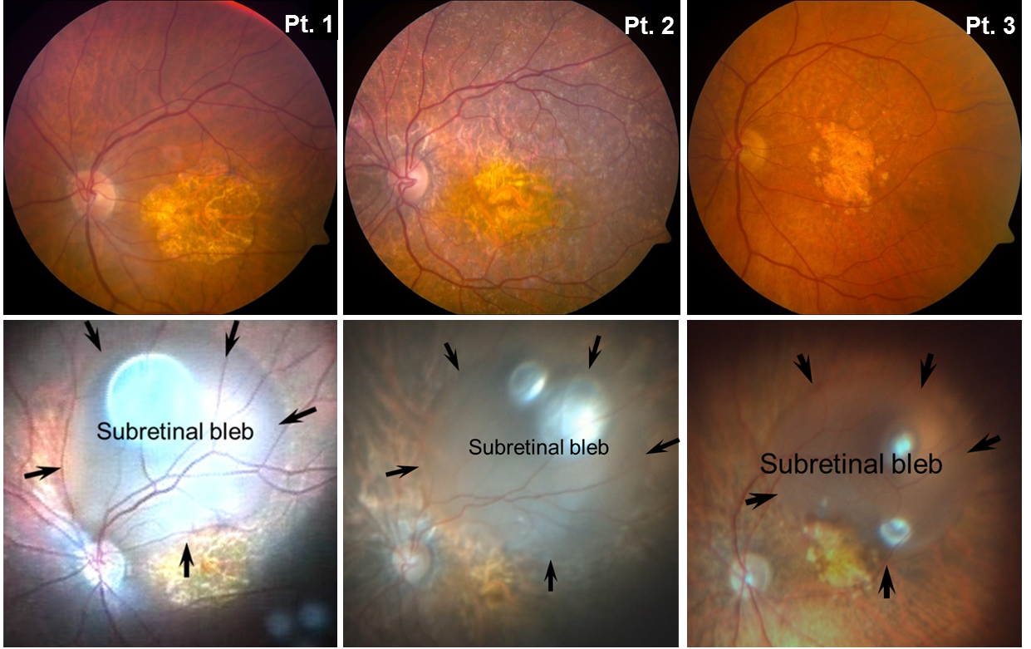
Representative Color Fundus Imaging
Pre-op
Intra-op

Slide 13
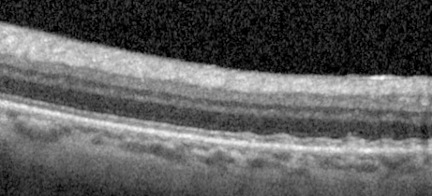
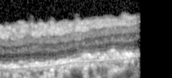
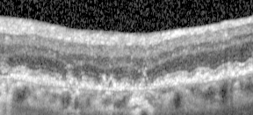
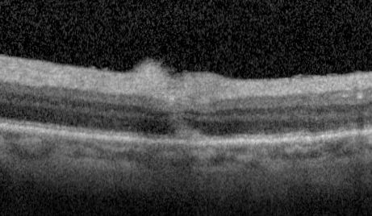
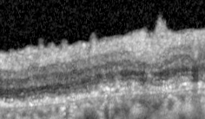
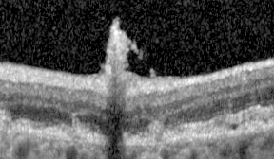
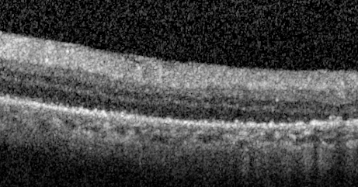
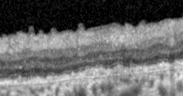
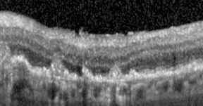
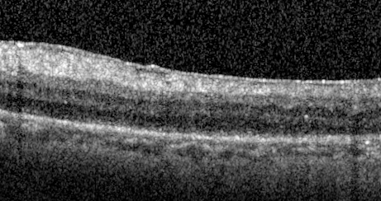
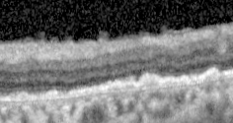
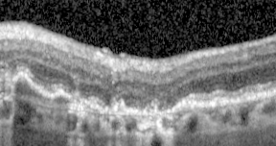
Rapid Healing of Injection Site
Subject 1
Subject 2
Subject 3
Baseline
Precise location of subretinal injection indicated by red arrow
1 Day Post-op
2 Weeks Post-op
1 Year Post-op

Slide 14
Study Update

Slide 15
Study status
Cohort 1-3 recruitment completed
Cohort 4 recruitment ongoing
Cohort | 1-3 | 4
N (%) of subjects screened | 54 (100%) | 17 (100%)
N (%) of screening failures | 42 (78%) | 14 (82%)
N (%) subjects treated | 12 (22%) | 3 (18%)
N (%) subjects dropout | 1 (8 %) | 0
Post-implantation cumulative FU period | 15.1 years | 1.7 years
Mean FU (days) | 339.3 (SE ± 97.9) | 208.7 (SE ± 25.5)
Median FU (days) | 373.5 ((63*) 189-1067 days) | 195.0 (173-258 days)
* Dropout subject

Slide 16
Baseline characteristics for cohorts 1-3 and 4
Cohort/ Parameter | 1-3 N=12 | 4 N=3
Age: mean (SD/min-max) | 78.3 (± 8.2/64.8-92.2) years | 77.1 (± 3.1/74.6-80.6) years
ETDRS BCVA: mean (SD/min-max) | 23.7(± 11.7/0-39) letters* | 55 (± 13.5/42-59) letters*
GA area: mean (SD/min-max) | 12.7(± 7/6-30) mm² | 7.1 (± 1.4/5.5-8.3) mm²
Known duration of AMD: mean (SD/min-max) | 100 (± 52.7/35.7-195.4) months | 82 (± 23.7/66.8-99.2) months
*Conversion of ETDRS letters to approximate Snellen equivalent
23 = 20/400 39 = 20/160
42 = 20/160 55 = 20/80 59 = 20/63

Slide 17
Primary endpoints: systemic and ocular safety and tolerability-Part I
Safety and Tolerability
  BCVA remained largely stable over time in treated eyes
    One cohort 4 subject experienced a marked improvement
    One cohort 4 subject experienced a sharp decline due to ERM, BCVA returned to few letters above baseline after ERM peeling
    One cohort 1 subject experienced a sharp improvement followed by a decline but yet above baseline
  GA remained largely stable over time in treated eyes
  No IOP elevations occurred
  All subjects reported at least one AE (N=246)
  Most AEs were of mild intensity (88.6%)
  Most frequently reported systemic disorders
    Asthenia and malaise reported by 4 subjects
    All others AEs reported were single events with no trends

Slide 18
Primary endpoints: systemic and ocular safety and tolerability-Part II
Ocular Safety and Tolerability
  The most reported AEs were related to Eye Disorders System; most frequent were:
    Conjunctival Hemorrhage after surgery – reported by 8/ 15, recovered rapidly
    Eye irritation – reported by 1 subject
    Subretinal fluid persisting over 24hr post-injection reported by 4 subjects, all absorbed within 72hr
    Subretinal pigmentation – developed in 8 subjects (as reported by site)
    One subject developed CNV over two years after implantation
    Epiretinal Membrane (new/worsening) – reported by 13 subjects, most mild to moderate,
    one required interventional surgical peel, which was successful
    Lamellar hole reported by 2 subjects (associated with ERM)
    Retinoschisis (related to ERM) – reported by 1 subject
  Two Ocular SAE
    Retinal detachment was reported in one subject 2 weeks after surgery. Unknown whether a result of surgical procedure, implanted cells, or a combination of events
    In one subject a severe ERM developed rapidly after surgery – intervention required – ERM peel was performed successfully – BCVA improved to a few letters above baseline, retinal structure restored

Slide 19
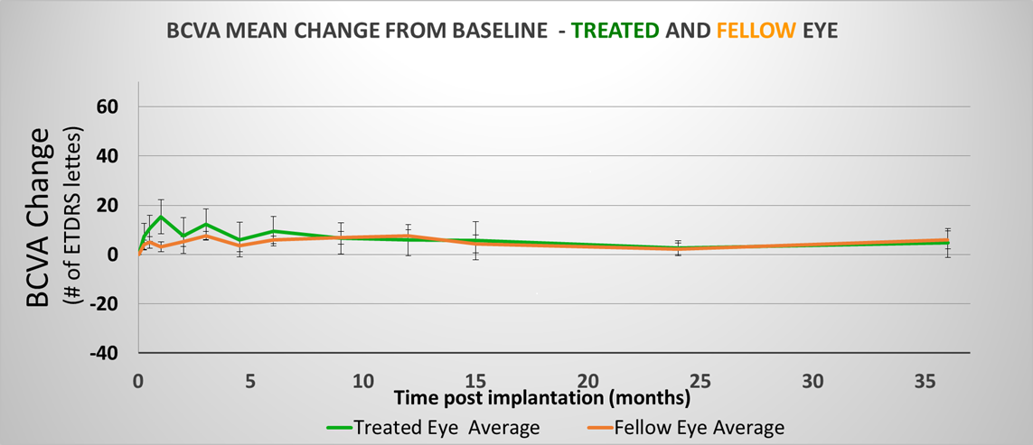
Cohorts 1-3: BCVA change from baseline over time (n=12)

Slide 20
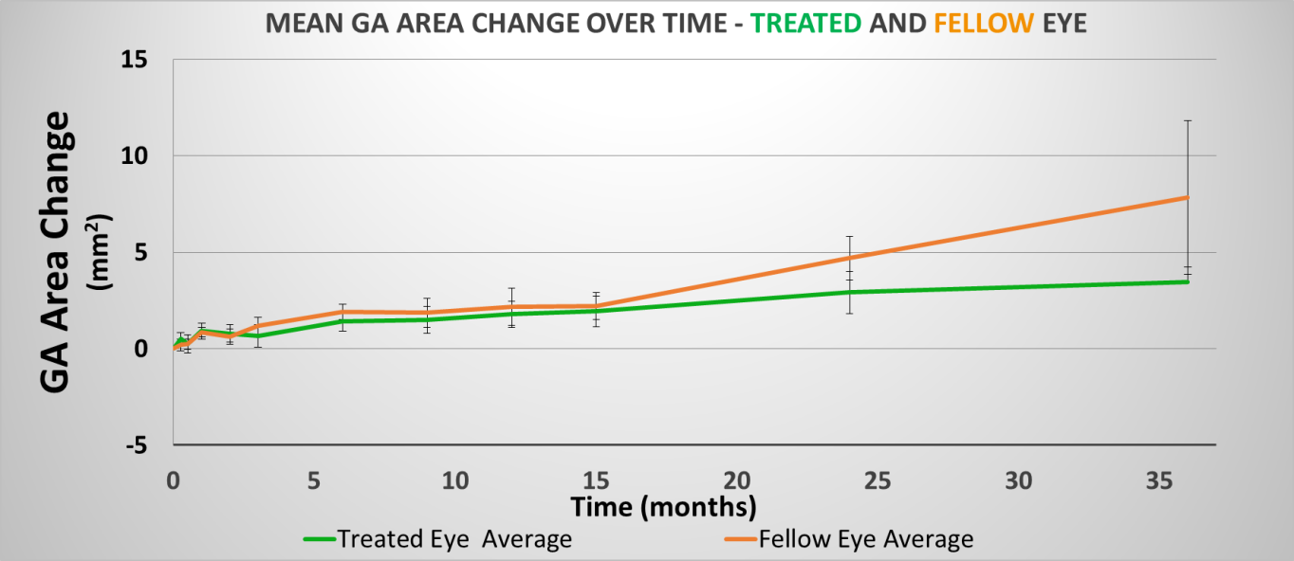
Cohorts 1-3: GA area change from baseline over time (n=12)
GA area as measured from FAF images by central reading center

Slide 21
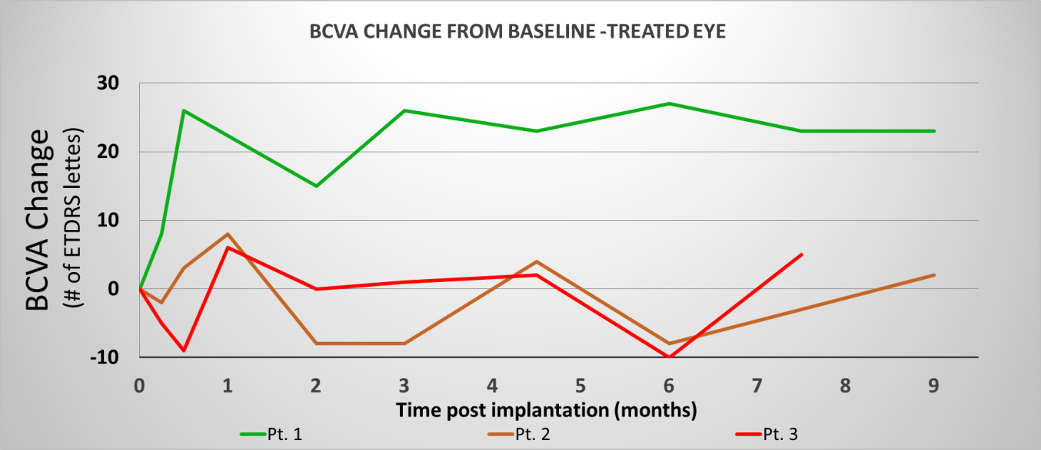
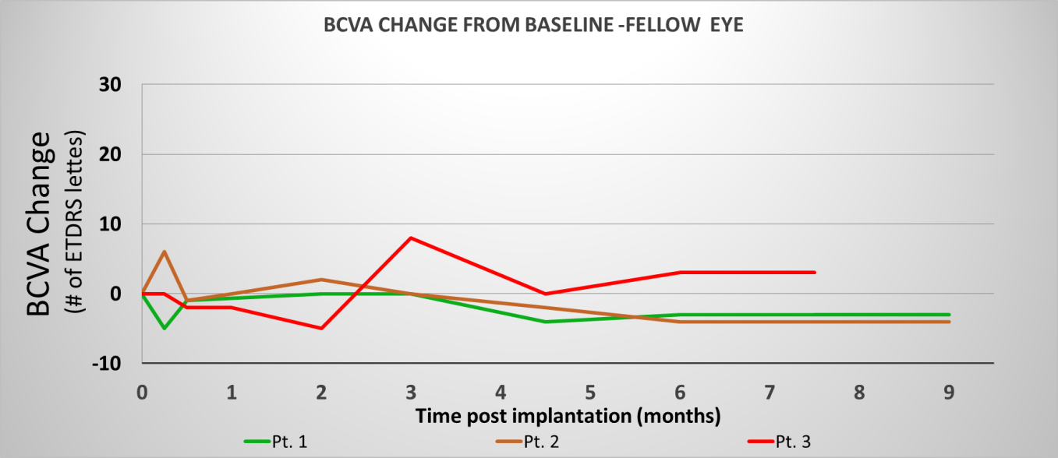
Cohort 4: BCVA change from baseline over time (n=3)
Treated Eye
Fellow Eye

Slide 22
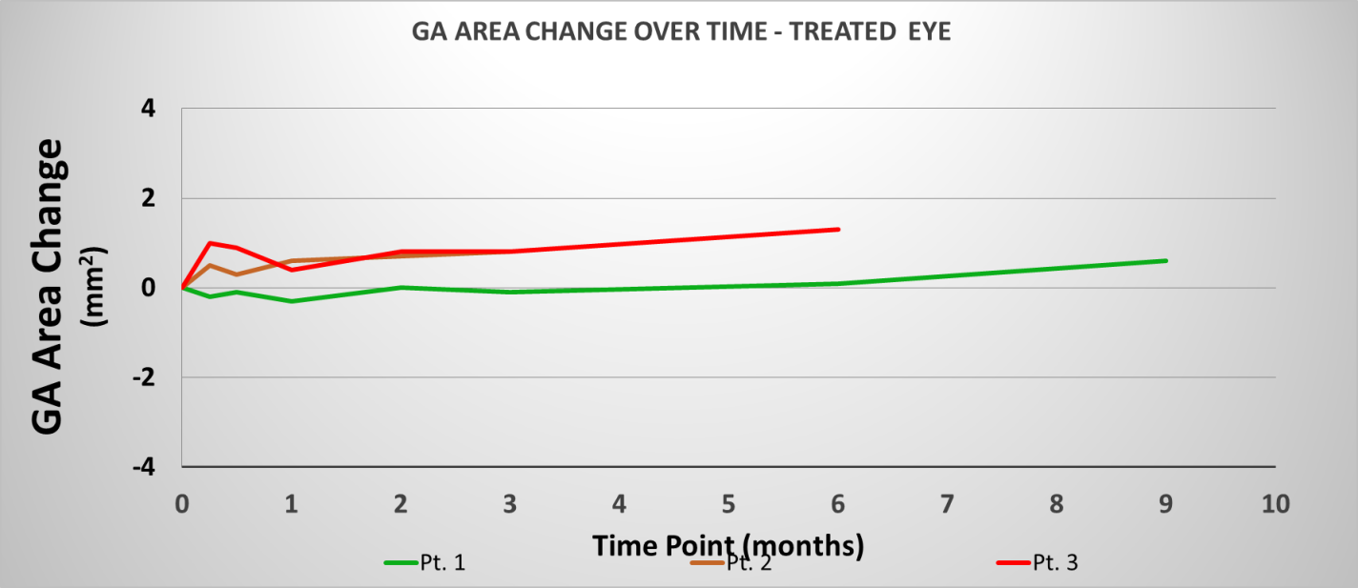
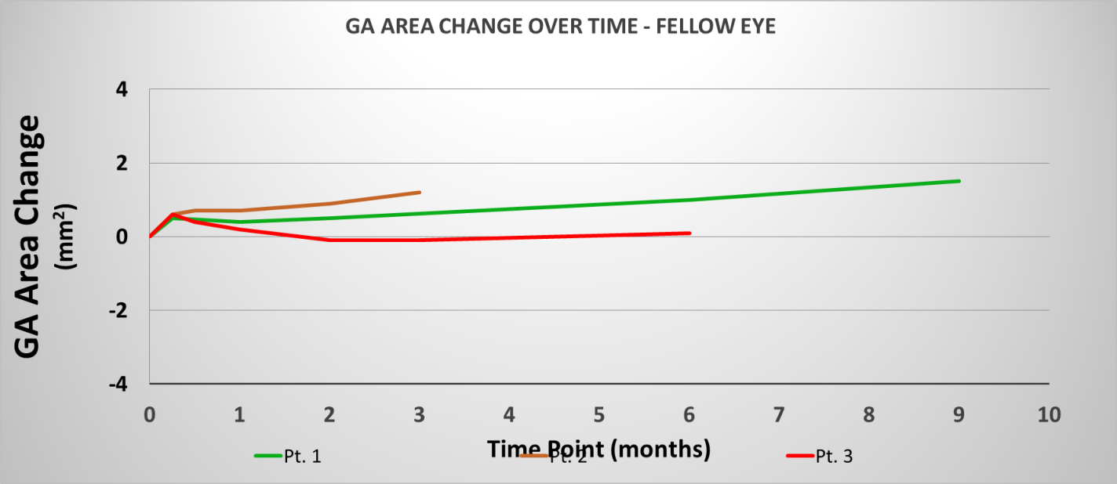
Cohort 4: GA area change from baseline over time (n=3)
Treated Eye
Fellow Eye

Slide 23
Study outcomes of secondary endpoints: Imaging findings that may support presence and survival of transplanted cells
As per Reading Center, 10 out of 15 subjects show new subretinal hyperpigmentation after hESC-RPE transplantation
In 7 out of 15 cases, irregular hyper-reflectivity at RPE level observed on OCT
In 9 out of 15 cases hypo- and hyper-fluorescent spots observed within treated area on FAF
Notes:
As per Reading Center (, 109, 111,, 117,402, 203, 503,802,602,120,207)
irregular hyper-reflectivity (102, 109, 111, 402, 802, 207, 120)
hypo- and hyper-fluorescent (102,109,111,113,402,203,503,802, 120)

Slide 24
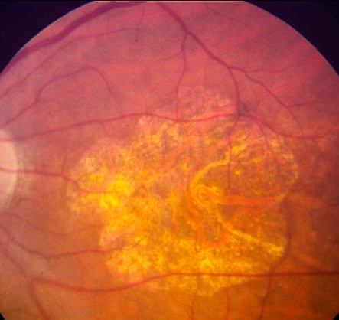
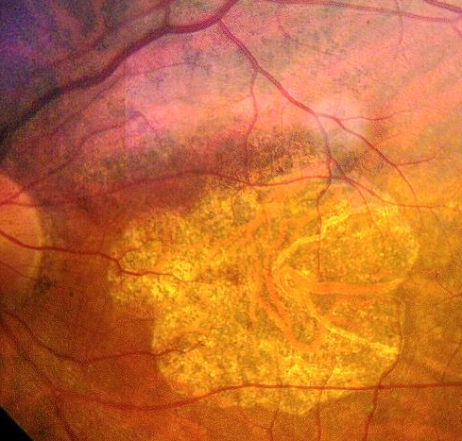
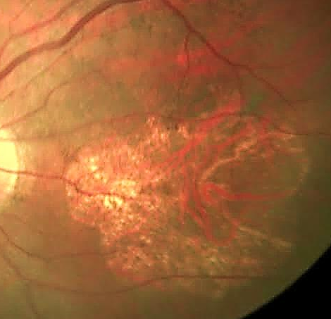
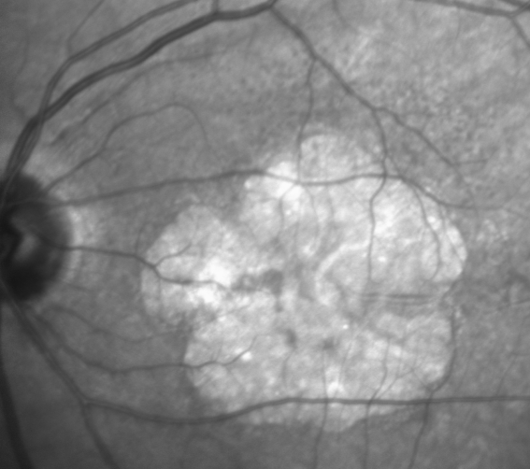
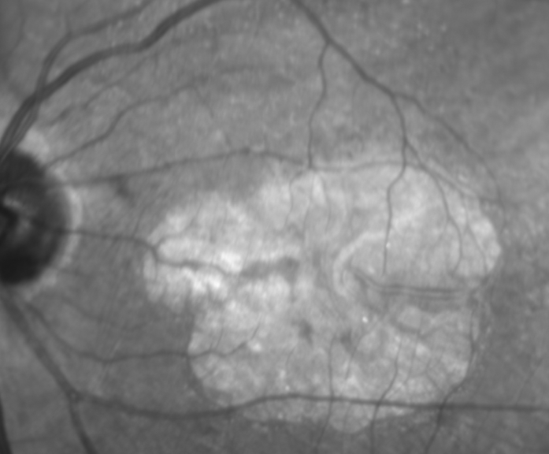
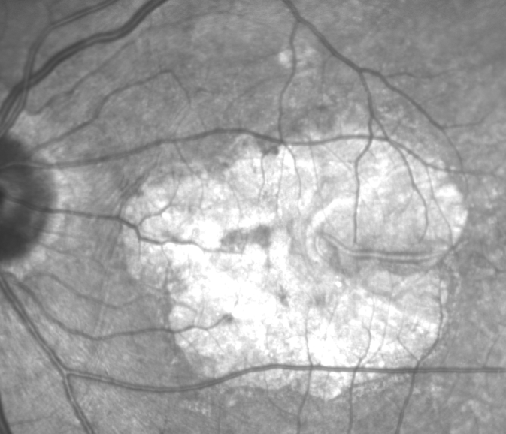
Subject 1
CFP
1 year
IR
Baseline
2 Months
12 Months

Slide 25
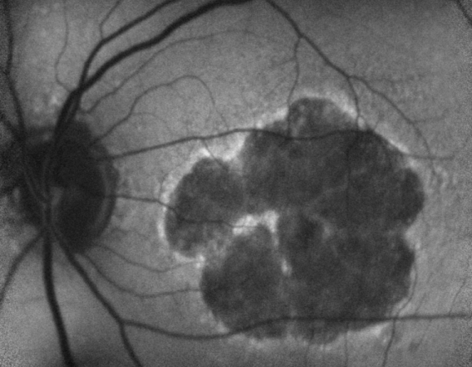
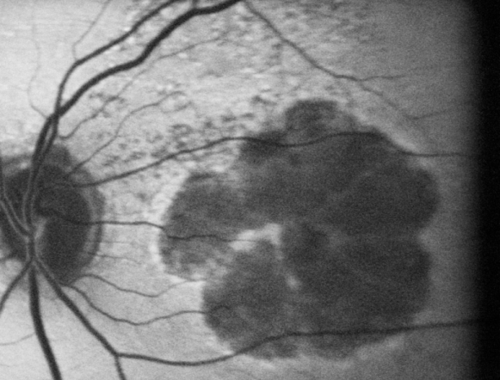
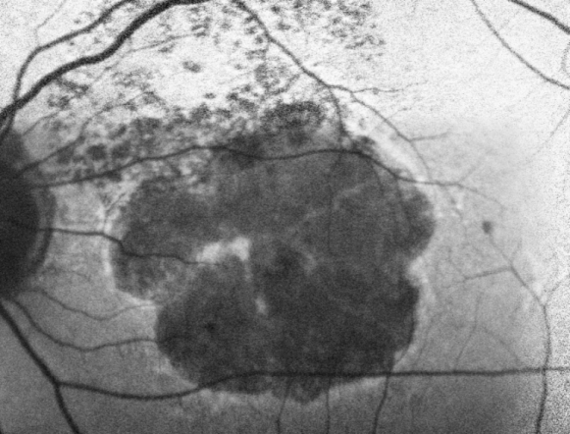
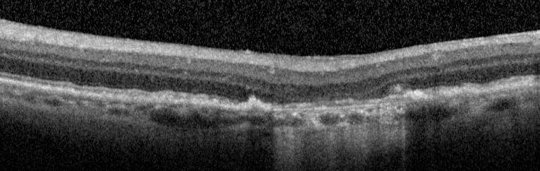
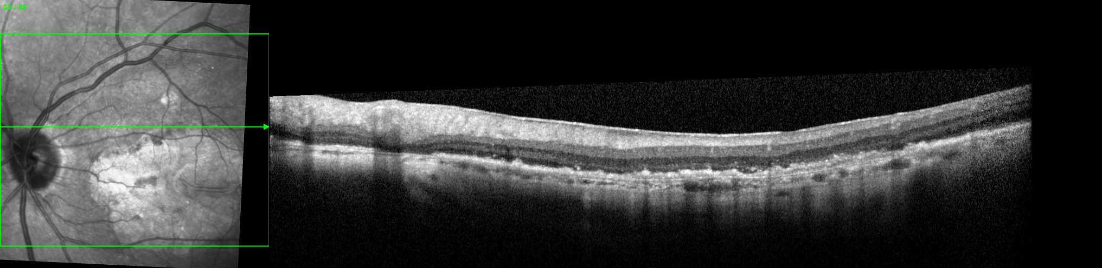

Subject 1
FAF
Baseline
1 Month
9 Months
Baseline
18 Months
OCT
1 Month
36 Months
25
bleb border, Sub retinal injection location, GA border, Irregular hyper-reflectivity

Slide 26








Subject 4
FAF
OCT
Baseline
Baseline
6 Months
CFP
6 Months
Baseline
3 Months
24 Months
24 Months
26
Bleb border, Subretinal injection location, GA border, Irregular hyper-reflectance

Slide 27







Subject 2
CFP
FAF
OCT
Baseline
Baseline
Baseline
Baseline
1 Month
Bleb
24 Months
24 Months
36 Months
Bleb
27
Bleb border, Subretinal injection location, GA border, Irregular hyper-reflectance

Slide 28



TRA-1-85 (human marker) Dapi (nuclear marker)
OpRegen engraftment and survival in swine
Bleb border, irregular hyper-reflectance in outer retina

Slide 29

Subject 2
GA at baseline (red-violet) Versus 36 months (light blue)
Dashed Green line- bleb border

Slide 30

Subject 9
GA at baseline (red-violet) Versus 12 months (light blue)
Dashed Green line- bleb border

Slide 31









Subject 8
Baseline
1 month
2 months
12 months
Baseline
1 Month
12 Months
Bleb border, Subretinal injection location, Irregular hyper-reflectance

Slide 32






Treated Area
Selected images of Drusen reduction
Baseline
1 month
Baseline
2 months
12 months
Untreated Area
Baseline
12 months
15 months
Bleb border, Subretinal injection location, Irregular hyper-reflectance

Slide 33

Subject 8: Baseline vs 12 months –
Shows changes are being maintained

Slide 34




Case Report- Cohort 4, Subject 14
Baseline
Intra OP bleb
2 months
(2 weeks before ERM peel)
3 months
(2 weeks after ERM peel)

Slide 35




Case Report
Baseline
Baseline
Baseline
2 months (2 weeks before ERM peel)
3 months (2 weeks after ERM peel)

Slide 36




Case Report
Baseline
9 months
9 months

Slide 37


Case Report
?
9 month

Slide 38
Case Report
9 months
9 month
Baseline

Slide 39
Case Report
Baseline
9 months
Nasal Border of GA
9 month

Slide 40

Case Report
Baseline
9 months
Temporal Border of GA

Slide 41



Case Report
Baseline
9 months
Superior Border of GA

Slide 42


Case Report
Baseline
9 months
Inferior Border of GA

Slide 43
Summary (I)
Following subretinal transplantation of OpRegen (hESC-RPE) in suspension there is rapid healing of the injection sites, and visual acuity remained largely stable throughout the study with follow-up of up to 36 months in the first-treated subjects
Subretinal pigmentation in the treated area is observed in 10/15 subjects, which has remained stable for up to 3 years in some subjects
There are additional signs suggesting potential RPE engraftment in the area of implantation, particularly subretinal hyper-reflective areas seen on OCT both in human subjects and in pigs; in the pigs this correlated with presence of transplanted cells on histology
New or worsening ERMs were observed in 13/15 subjects in cohorts 1-4, most were mild to moderate in severity. One required intervention and the ERM was peeled 10 weeks post transplant with full recovery
There was one case of retinal detachment 2 weeks post-op, unknown whether a result of surgical procedure, implanted cells, or a combination of events
43

Slide 44
Summary (II)
In general, subretinal transplantation of OpRegen appears well tolerated to date and there are signs indicative of improved retinal structure in the treated areas in some cases. This requires additional follow-up and observation
Cohort 4 is ongoing, treating subjects with better vision, smaller areas of GA, with a known history of recent progression
Alternative methods of surgical delivery are under consideration
Exploration of suprachroidal route of administration for subretinal injection using the FDA 510K cleared Orbit Subretinal Delivery System (SDS) will begin shortly
Stable bleb
(no retinotomy)
cannula
44

Slide 45
Thank you!

